Slide 1
Planting mangrove trees at Bang Pu Nature Education Center, Samut Prakan province
Date : Saturday, February 11, 2023
Time: 8:00 am. -15:00 pm.
Participant: 200 students (Students who study GE1301,1302, 1303)
Expense: 60 baht for 3 mangrove saplings/ person
***Free coach and lunch***
If you would like to plant mangrove trees for the term project, please reserve a seat. (Everyone has to reserve a seat)

Slide 2
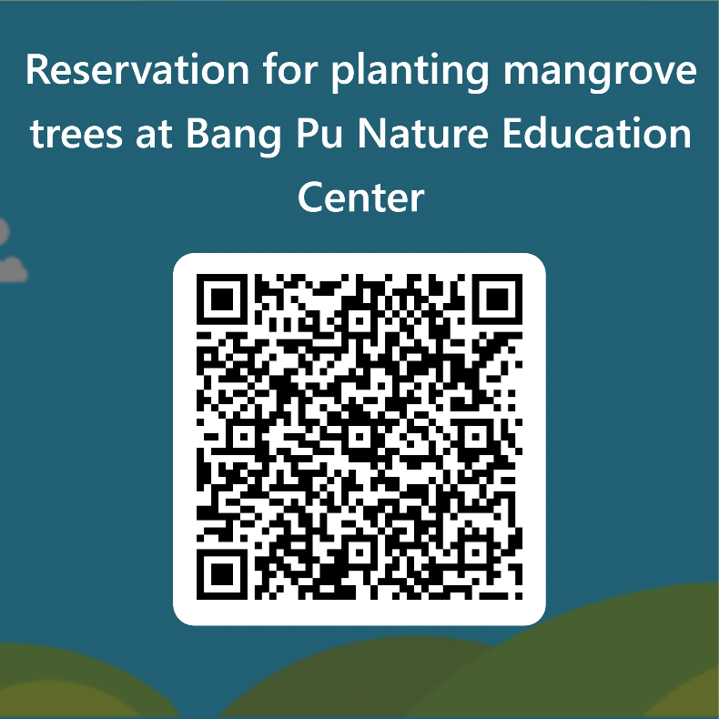
Planting mangrove trees at Bang Pu Nature Education Center, Samut Prakan province
How to reserve your seat?
Reserve via MS form by scan QR code.
The link will be opened on
Jan 24, 2023 from 8:00 am. to 13:00pm.
(First come, first serve)
If you get the quota, your name will be
announced then you have to pay
60 Baht for 3 mangrove saplings
( give money (only cash) to your lecturer)

